Slide 1
Location Based services
PAVAN KUMAR DASARI
5G UCL

Slide 2
Overview
Use of Location services in android application
Finding ATM’s using google maps
Checking permissions from user to enable location
Application Demo

Slide 3
Location services in an Android app allow the app to determine the current location of the device. This can be very useful for apps like navigation, finding nearby places.
location services help your app figure out where the device is, and then you can use this information to provide relevant features to the user, like showing weather, finding nearby places.
Get User Location Permission:
Ask the user if your app can access their location. If they agree, you can find where they are.
Show Google Map:
Display a map on the app's screen using Google Maps API.
Mark User's Location:
Place a marker on the map to show where the user is located.
Search for ATMs:
Use Google Maps API to search for ATMs around the user's location

Slide 4
When an app wants to use a user's location, it needs to ask for permission first. This is like asking for permission to use a toy – you need to ask before you can play with it.
Asking for Permission:
When the app starts, it says, "Hey, can I use your location to show you the weather?" It asks this nicely so that the user knows what the app wants to do.
User's Decision:
The user decides if they want to say "yes" or "no." If they say "yes," the app can use their location. If they say "no," the app can't use their location.

Slide 5
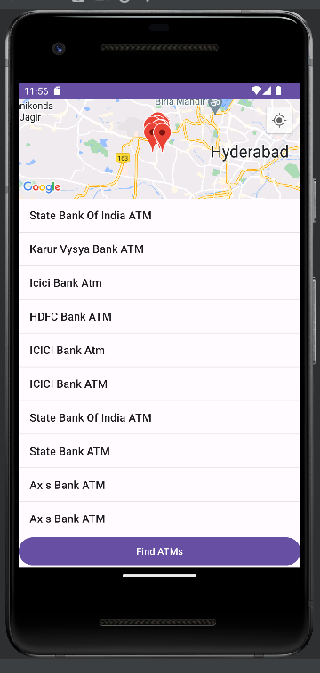
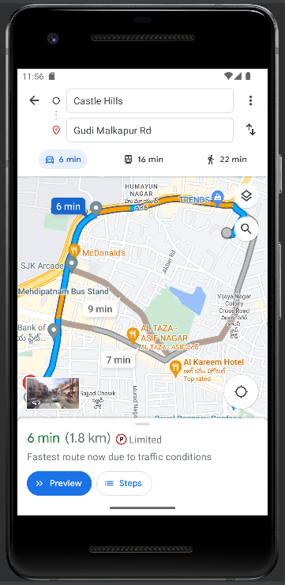
Home Screen
Location of the selected ATM

Slide 6
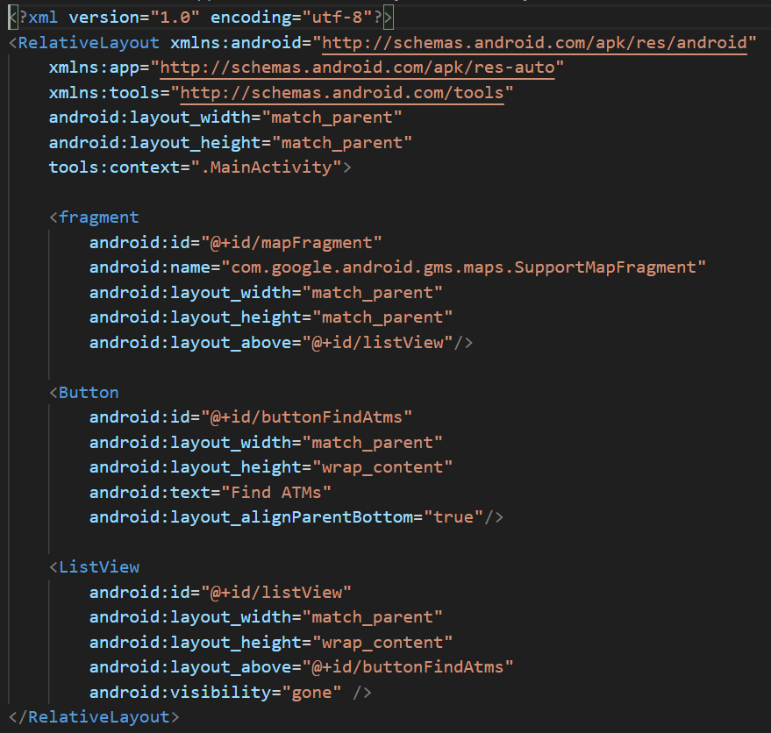
Fragments are like small, reusable parts of your app's user interface. They're like building blocks that you can put together to create your app's screen.
A ListView is like a scrollable list that displays items vertically. It's used to show collections of data, like your list of tasks.
It automatically handles scrolling when the list is longer than the screen.

Slide 7
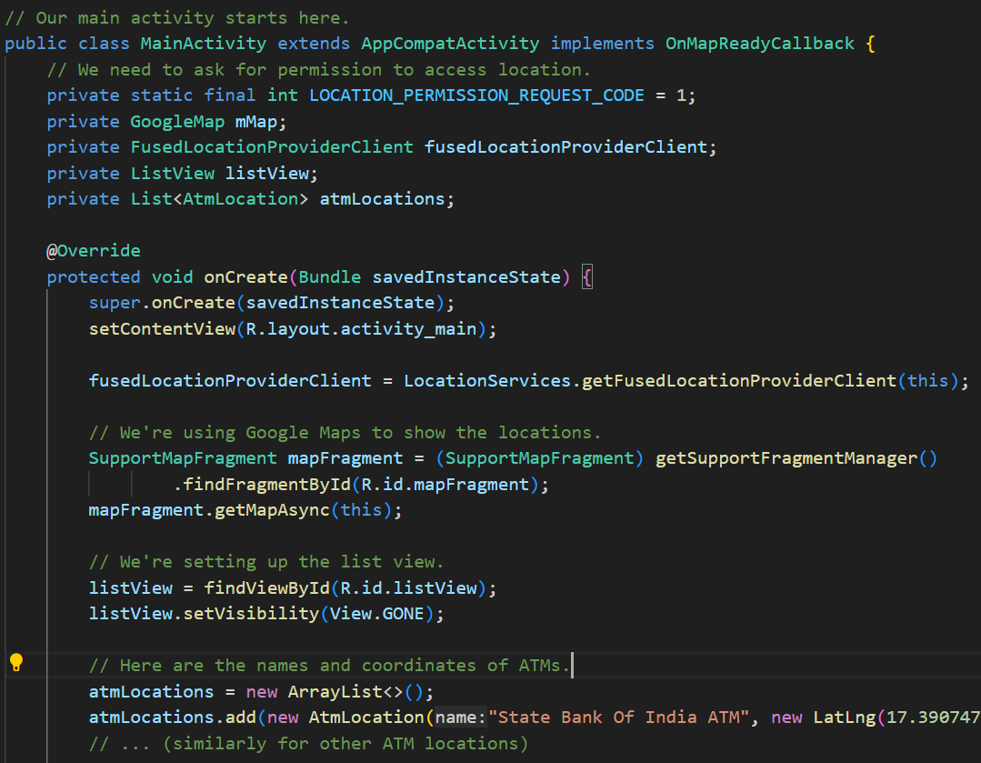
LocationServices.getFusedLocationProviderClient(this), you are requesting an instance of the Fused Location Provider Client that you can use to interact with location services.
Imagine you're building a travel app that lists popular tourist destinations. You can use an ArrayList to store the names of these destinations

Slide 8
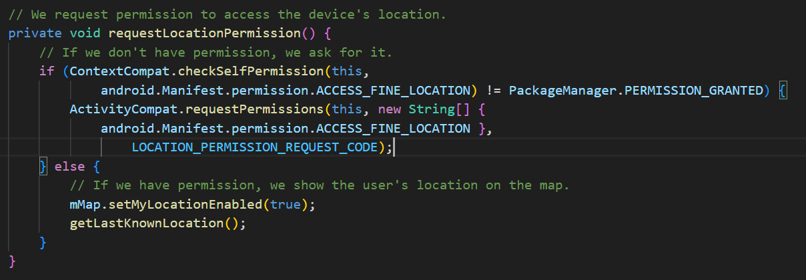
The requestLocationPermission() function is used to ask the user for permission to access their device's location.
app needs to access the user's location
getLastKnownLocation(); on permission granted the pointer moves to lastknowLocation of the user

Slide 9
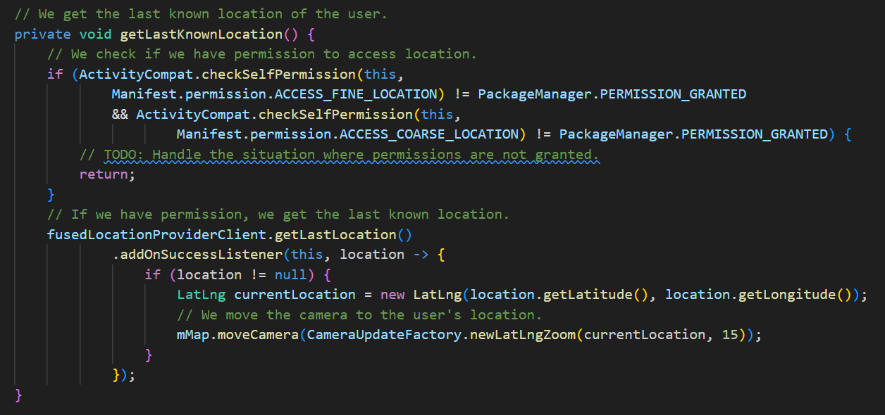
Here we are checking for location of the user and getting the user’s location

Slide 10
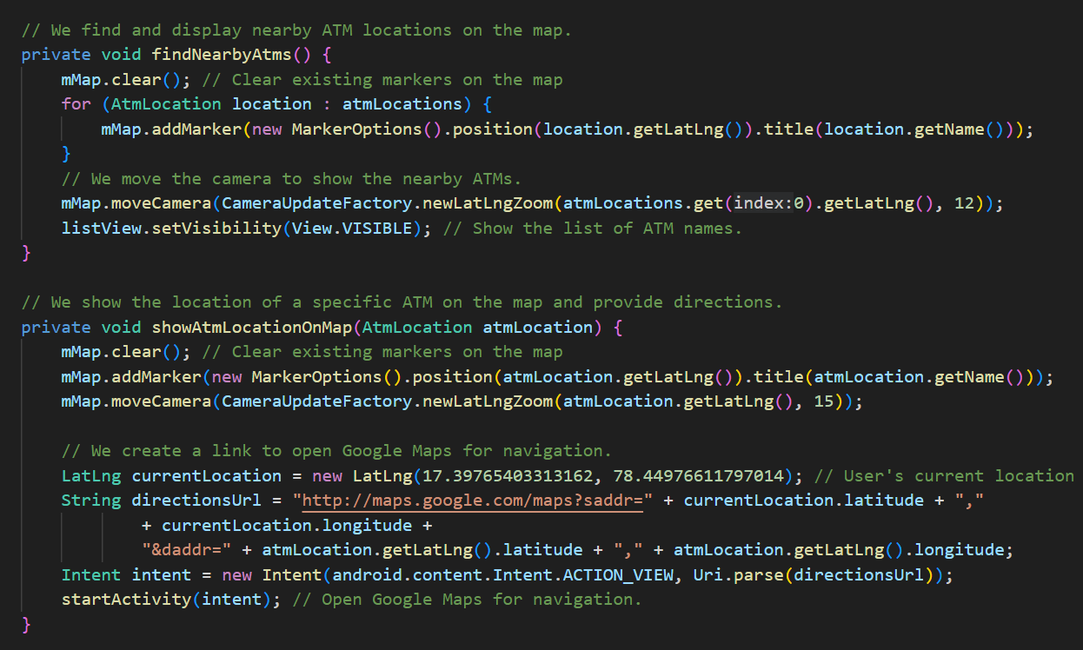
findNearbyAtms() function is responsible for showing nearby ATM locations on the map.
showAtmLocationOnMap(AtmLocation atmLocation) function is used to display a specific ATM's location on the map and provide directions to reach that ATM.

Slide 11



AndroidManifest.xml file
AndroidManifest.xml file is used in an Android application to provide essential information about the app to the Android operating system. It serves as a configuration file that helps the system understand various aspects of the app's behavior, permissions, components, and requirements.
App Identity: It contains metadata about the app
App Components: It defines the app's components such as activities, services
Permissions: It lists the permissions that the app requires to access certain system features or user data.
This line requests permission to access the device's approximate location based on cell towers and Wi-Fi signals. It's used when your app needs general location information but doesn't require high accuracy.
It's important to request only the permissions that your app genuinely needs to function
Finally we need google maps api key to use maps

Slide 12
Here we have list of ATM’s near our location, After we select a specific ATM, then we will be navigated to ATM location by using google maps

Slide 13
THANK YOU

